Slide 1
BMS Pro
Software for plant breeding efficiency and innovation

Slide 2
What is BMS Pro?
An integrated software package designed to facilitate plant breeding processes, data management, analysis and decision support for any crop.
It contains a powerful database which automatically collects and integrates data from plant breeding activities such as genealogy, inventory, characterization and evaluation.
This database becomes a permanent institutional knowledge resource to monitor progress and facilitate strategic decisions.

Slide 3
BMS Pro
A suite of interconnected software applications specifically designed to help breeders manage their day-to-day activities:
Program management
Customise preferences and monitor program activities
It is a dashboard application with integrated tools to manage and query crop information across the system
Breeding activities
Make crosses, advance nurseries and prepare trials
manage seed inventories
keep continuous records season after season
Marker-assisted breeding
Select germplasm and design crosses by complementing phenotypic selection with marker technology, for integrated breeding decisions
Statistical analysis
Analyse field and lab data with powerful statistics and mixed model comparisons of locations and genotypes

Slide 4
Deployment
BMS Pro is designed to be deployed as a multi-user system on a LAN or on a server in the cloud. In this way:
Distributed breeding teams can work on the same program
Institutional data and memory are preserved
Data is regularly and safely backed up
Support team/server manager provides updates and maintenance.
In special cases with small, remote breeding programs, BMS Pro can be deployed as a single-user desktop application

Slide 5
Deployment
Core modules of BMS Pro are open source. Codes are available on GitHub
A license in required for some analytical components, and comes with training and support from the IBP.
IBP is a partner in the BrAPI consortium providing common, open web services for integration of third party components to the BMS Pro experience.

Slide 6
BMS Pro – Who is it for?
BMS Pro is developed and deployed by the not-for-profit Integrated Breeding Platform (IBP)
Public Institutions
Breeding programs in developing countries (subsidized users)
Cross-institutional projects
Funded projects requiring multi-user collaboration (cost recovery)
Small-to-medium businesses (paying clients)
Universities
for research (cost recovery)
for teaching (subsidized)

Slide 7
Categories of users
Subsidized clients are people from public institutions in developing countries
receive BMS Pro products and support services free of charge
costs covered by external resources (donor funds, etc.).
All non-subsidized users can access BMS Pro products and services as paying clients.
Prices and conditions for license and services are scaled in accordance with the institution’s nature, size and region.

Slide 8
A support tool for education
Specific BMS training version
Installation on a local or web server
Concomitant use by multiple users
Backup and restore
Training data sets
Implementation of academic learning
Tutorials and practical exercises available
Test and compare different breeding approaches
Simulate breeding programme activities
BMS course can be part of the student accreditation
Added value to students an Universities:
Exposure to modern and comprehensive analytical pipeline
Facilitate integration into private companies
Same installation can include a production version for student practical work and/or teacher breeding activities.

Slide 9
Functionality

Slide 10
Core Applications
Program & information management
WorkBench (dashboard view)
Breeder Queries
Ontology Manager (9 crops)
Germplasm import tool
Data import wizard
Breeding activities
Germplasm List Manager
Crossing Manager
Nursery Manager
Seed Inventory
Trial Manager
Field maps and label printing
Statistical analysis – Breeding View:
Single-site analysis
Multi-site analysis
Multi-year multi-site analysis;
Single trait (single environment) QTL analysis
Marker-assisted breeding
Integrated Breeding Planner
Genotypic data management
MBDtool
OptiMAS

Slide 11
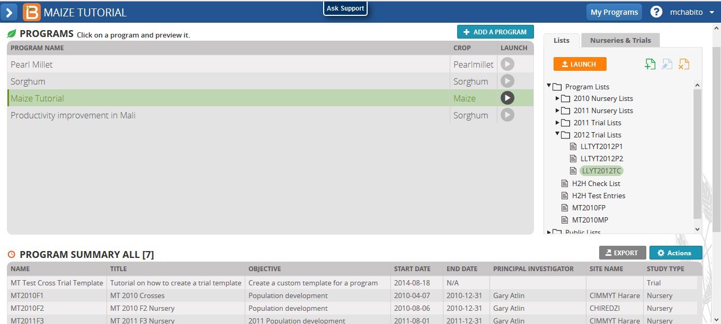
BMS Workbench – Multiple programs
The Workbench offers access to multiple breeding programs and allows users to add and remove programs as required.

Slide 12
Roles and Permissions
Administrators control user access to the system by assignment of customizable roles and permissions
Admin, Breeder or Technician

Slide 13
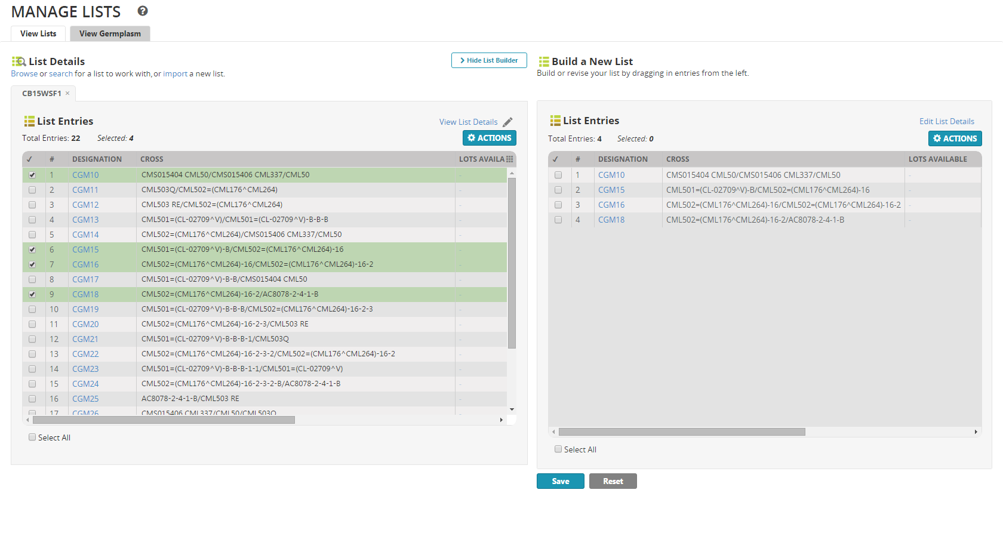
List Manager

Slide 14
Germplasm Details and Pedigree tree

Slide 15
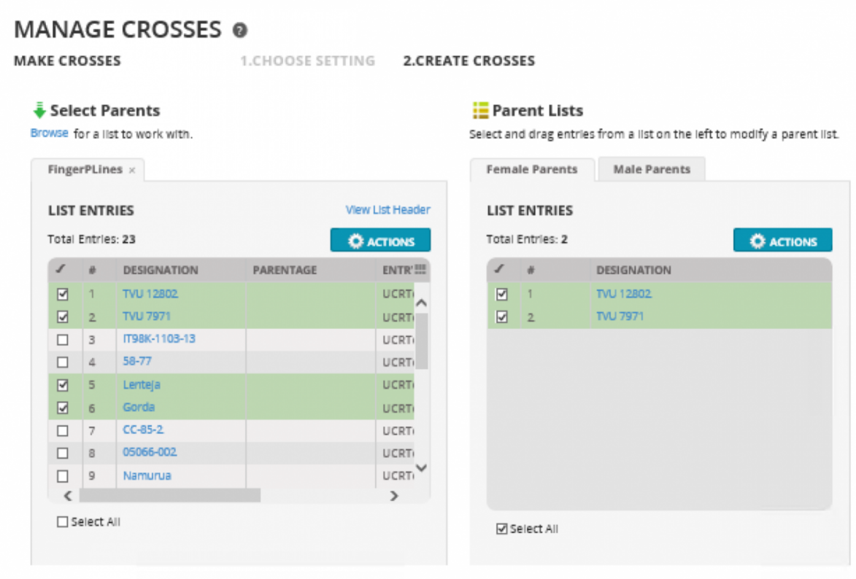
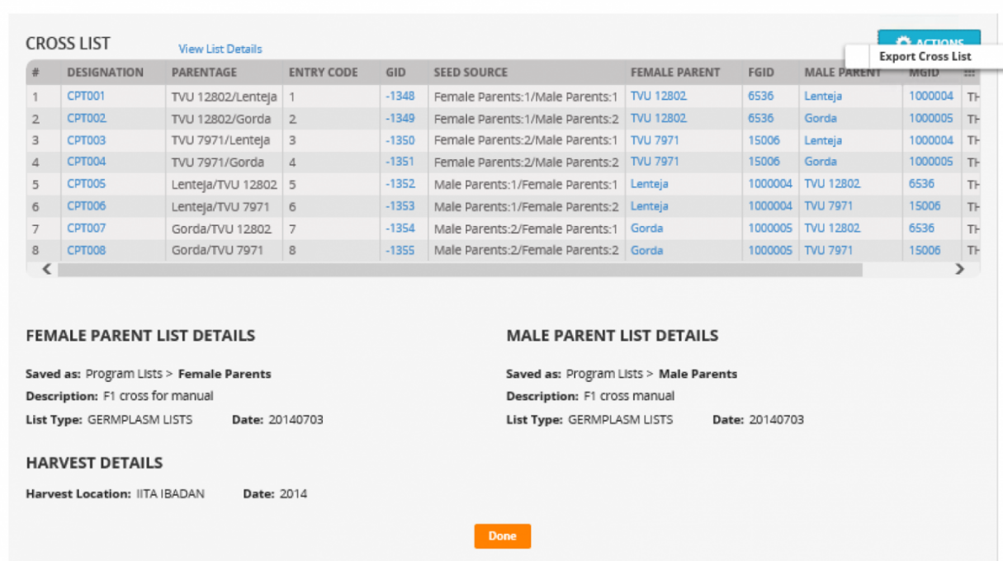
Crossing Manager or Export template
Deployed on server: Export template for designing crosses

Slide 16
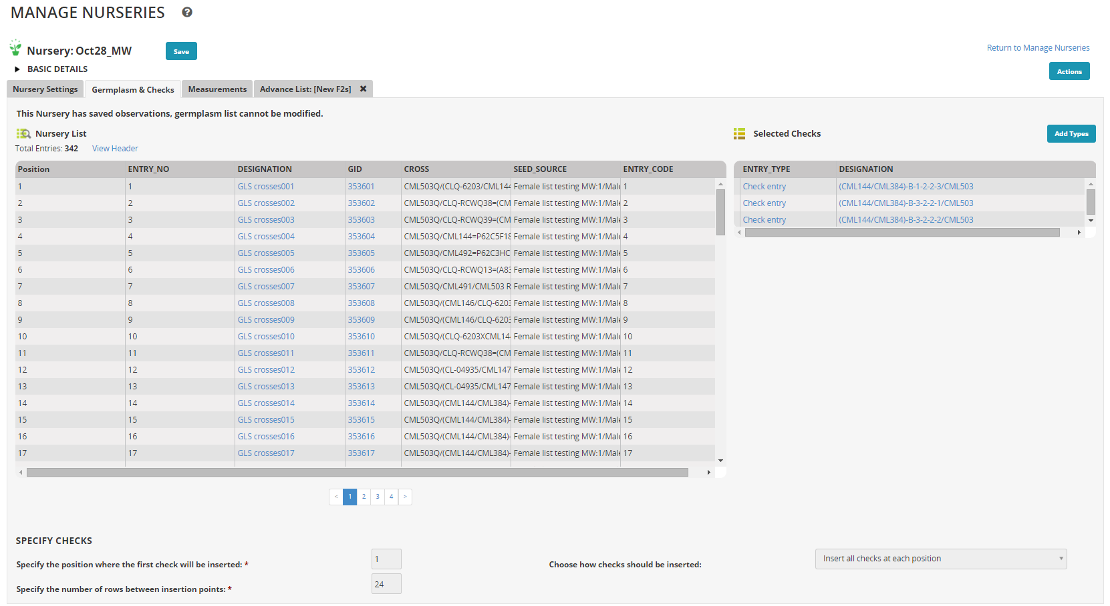
Nursery Manager

Slide 17
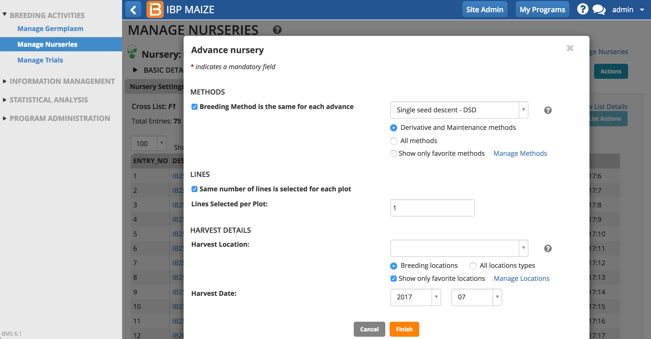
Advance Nurseries

Slide 18
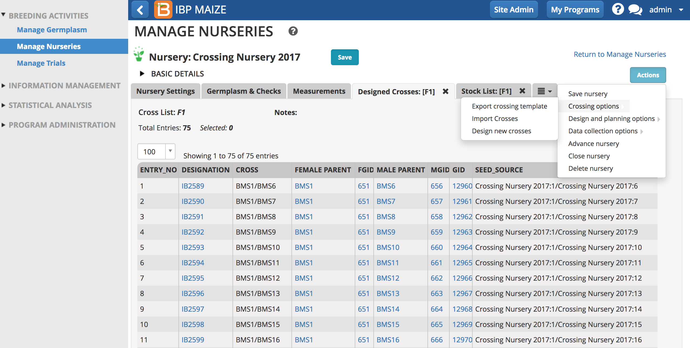
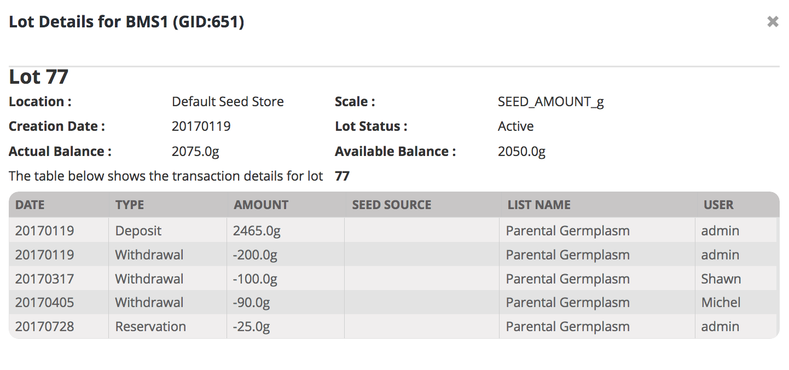
Seed Inventory: track seed stocks

Slide 19
Trial Manager: Field Testing
Field trials generated
describe the trial
select a list of germplasm for testing
specify the trial environment(s)
specify the trial design and generate the layout
(or import your own design)
specify traits to be measured and produce fieldbooks
Collect data
Printed fieldbooks
Electronic data capture devices
Check and store data

Slide 20
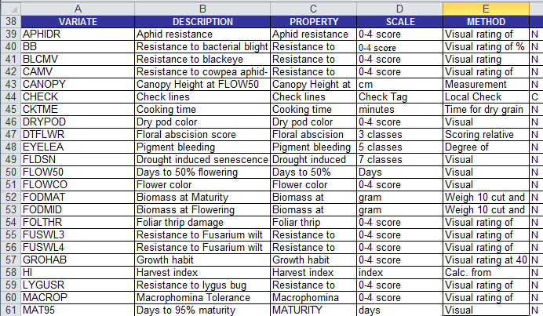
Crop Specific Trait Dictionaries
Measurement Variate
Trait property
Reporting units or scale
Measurement method

Slide 21
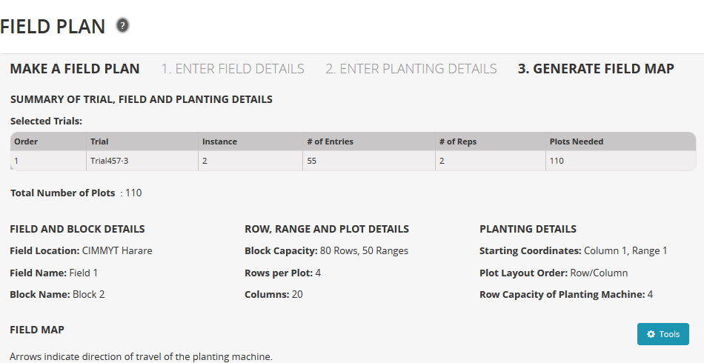
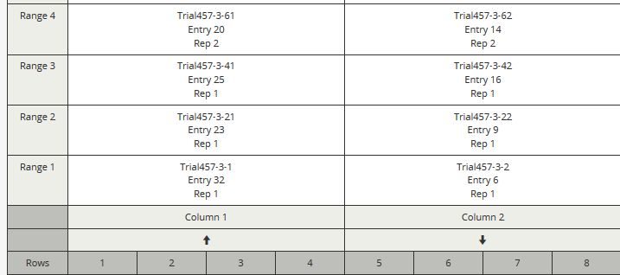
Field Plan

Slide 22
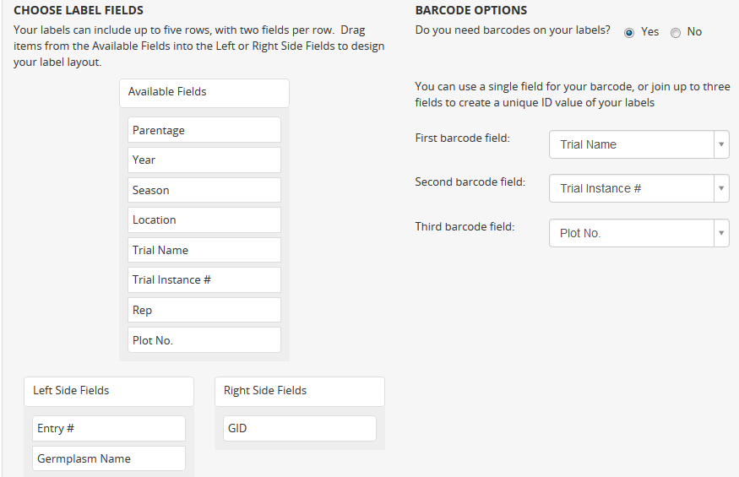
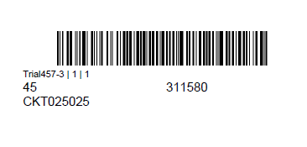
Labels

Slide 23
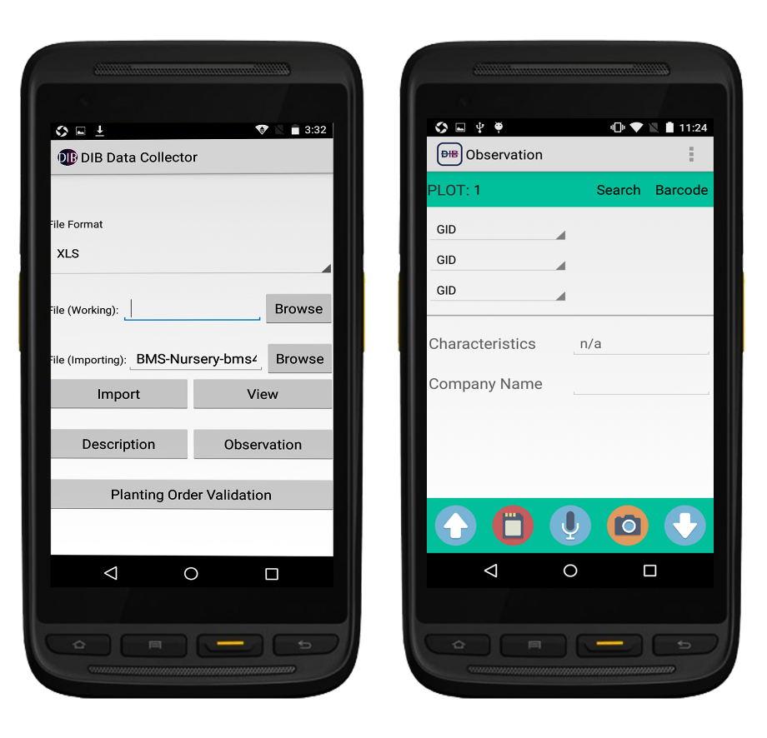
Electronic data capture
Connect to Android-based tablet devices for data collection in the field and laboratory; e.g.:
DIB Data Collector
(from BioSci Thailand, a DataLive partner)
Features
Robust
Anti-sunglare
Waterproof
Anti-Dust
Long life battery
Built in barcode reader
Interfaces directly with the BMS

Slide 24
Stats Analysis – Single Site

Slide 25
Stats – Multi site Analysis

Slide 26
Query Tools
At the outset of a breeding cycle users want to:
browse all germplasm information
review existing characterization and evaluation
search for adapted germplasm
perform head to head comparisons

Slide 27
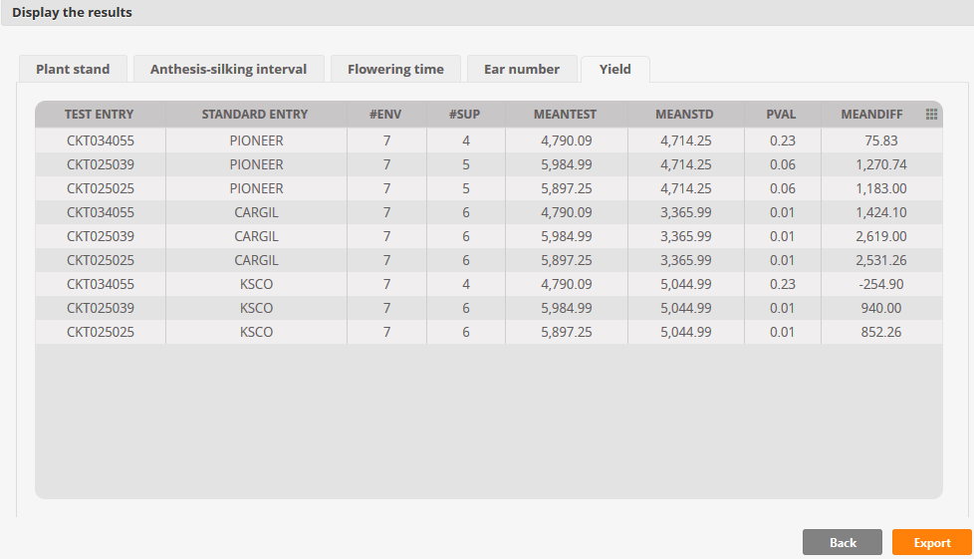
Head to Head Query
The H2H query searches the whole database for trials where specified pairs of standard and test entries have been tested together and then shows

Slide 28
Management and Analysis of Genotyping Data
The GDMS module allows users to integrate the use of molecular techniques into their breeding programs:
Order genotyping services
Import genotyping data
Search for polymorphic markers
Retrieve, view and analyse genotyping data
Key Functions
search genotyping data for a set of lines, retrieve and visualize these data and calculate a similarity matrix
search genotyping data for parents of a potential cross to confirm there are sufficient polymorphic markers
select available SNP markers (including any markers linked to a trait of interest) and create a genotyping order form

Slide 29
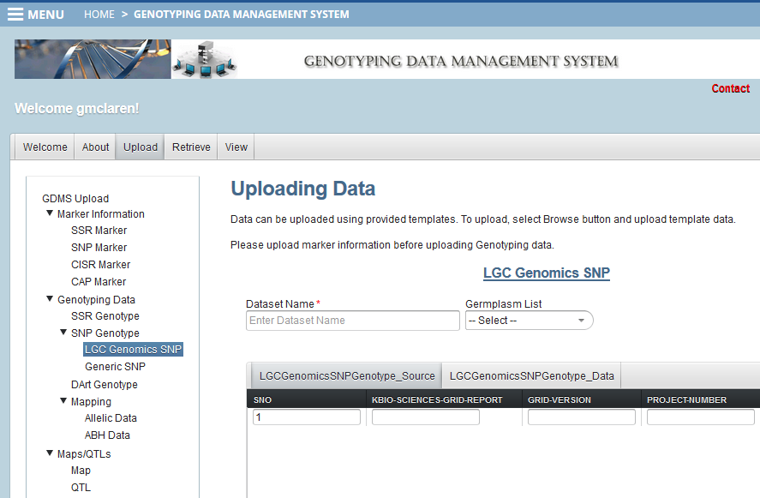
Uploading genotyping data

Slide 30
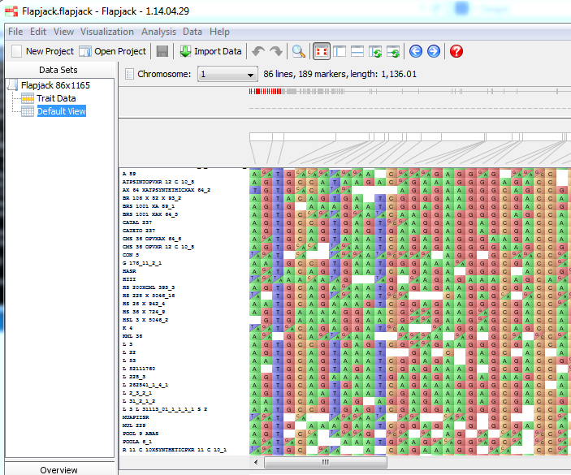
Visualization of genotyping data

Slide 31
Associated services

Slide 32
Targeted and dedicated support
Technical Support (IT):
Level 1 – Installation: implementing and getting started with the BMS and related tools
Level 2 – Operational: day-to-day use of the BMS PRO and related tools – hours in the bank with a service package
Professional Support (Breeders):
Customized breeding support primarily in developing countries
Capacity development and training in using the tools
Online Documentation
Complete user manual and step-by-step tutorials by crop
Instructional videos and e-learning modules

Slide 33
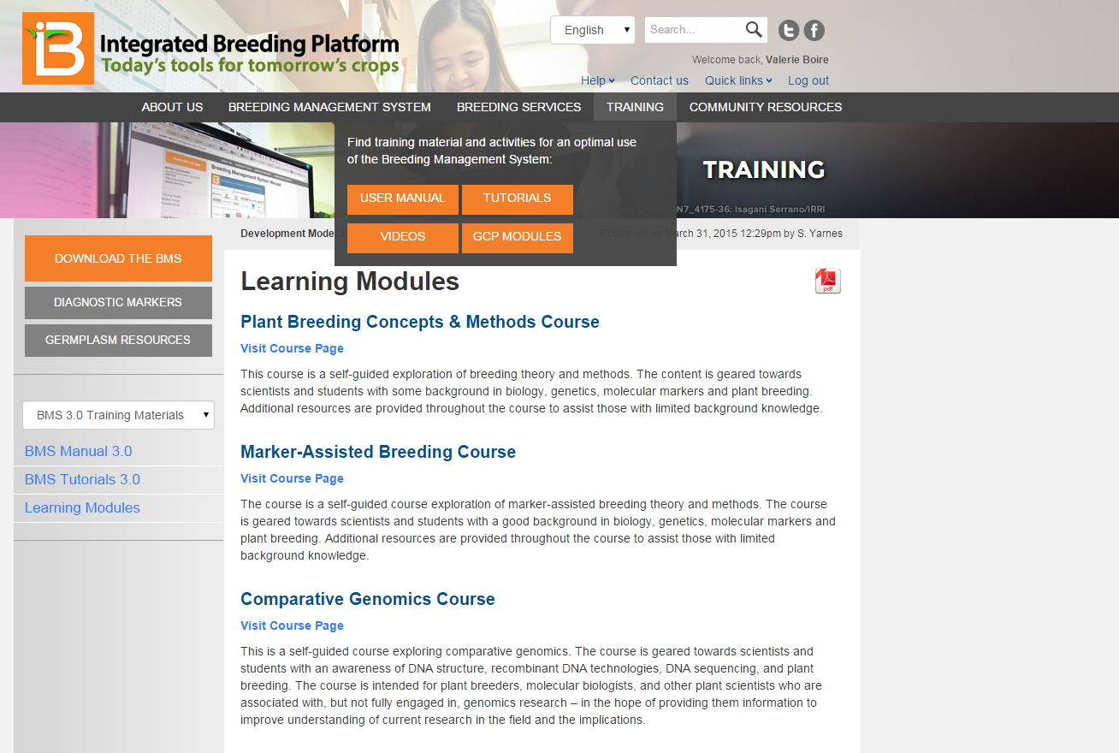
Documentation and training
www.IntegratedBreeding.net

Slide 34
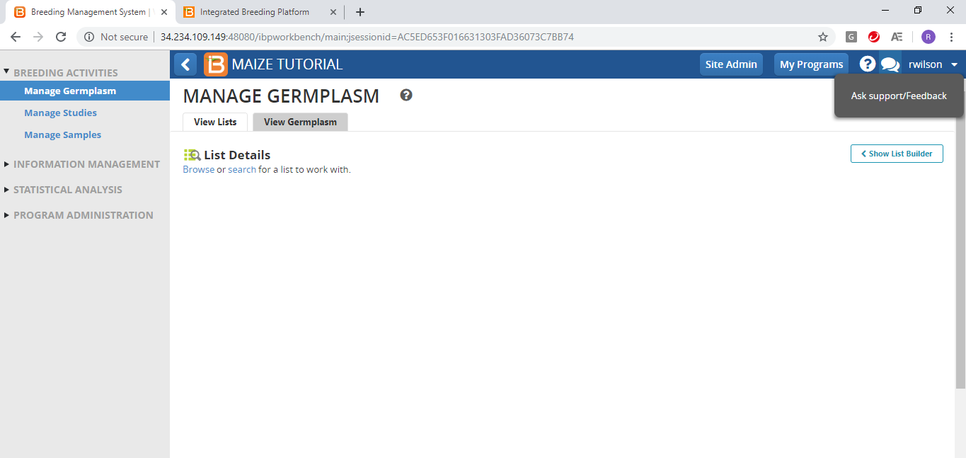
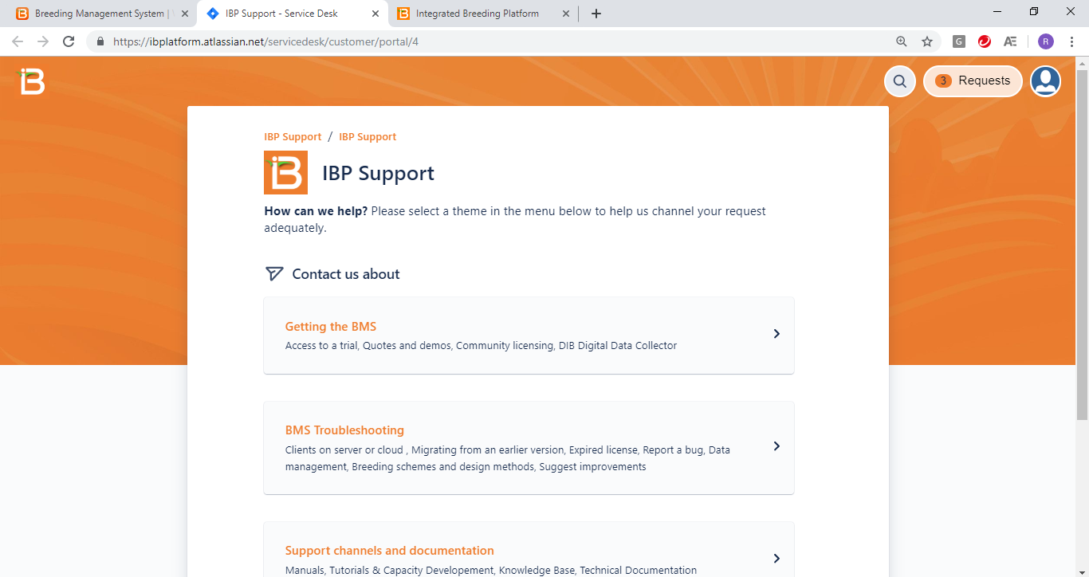
Online helpdesk & support

Slide 35
IBP: more than just the BMS – e.g. Markers; 3rd party services; etc.
www.IntegratedBreeding.net

Slide 36
Local support teams: providing assistance where you need it
Local staff
IBP Hubs
IBP HQ
IBP future Hubs

Slide 37
Value proposition:
all information in one place
1 software suite, 1 license, 1 provider
safe, standardized and centralized
no more loose pages or scattered excel sheets
more results in less time
collect & analyze in days rather than months
extract more data from each breeding cycle
institutional memory
keep records for an infinite number of generations
mitigate the brain drain effect
team collaboration
connect and share across decentralized locations
knowledge builds value
beyond collecting data observe trends, gain foresight and innovate
Credit (photo in tablet): N.Palmer/CIAT

Slide 38
Next steps:
Register on our website: www.integratedbreeding.net
Request a personalized demo of BMS Pro, and then access to a trial cloud server
Access tutorials, videos, publications and more
View other presentations, fact sheets and case studies
Join a Peer Community
Get special rates on breeding services through our network of providers
Our team will be happy to answer your questions!
deployment@integratedbreeding.net

